Slide 1
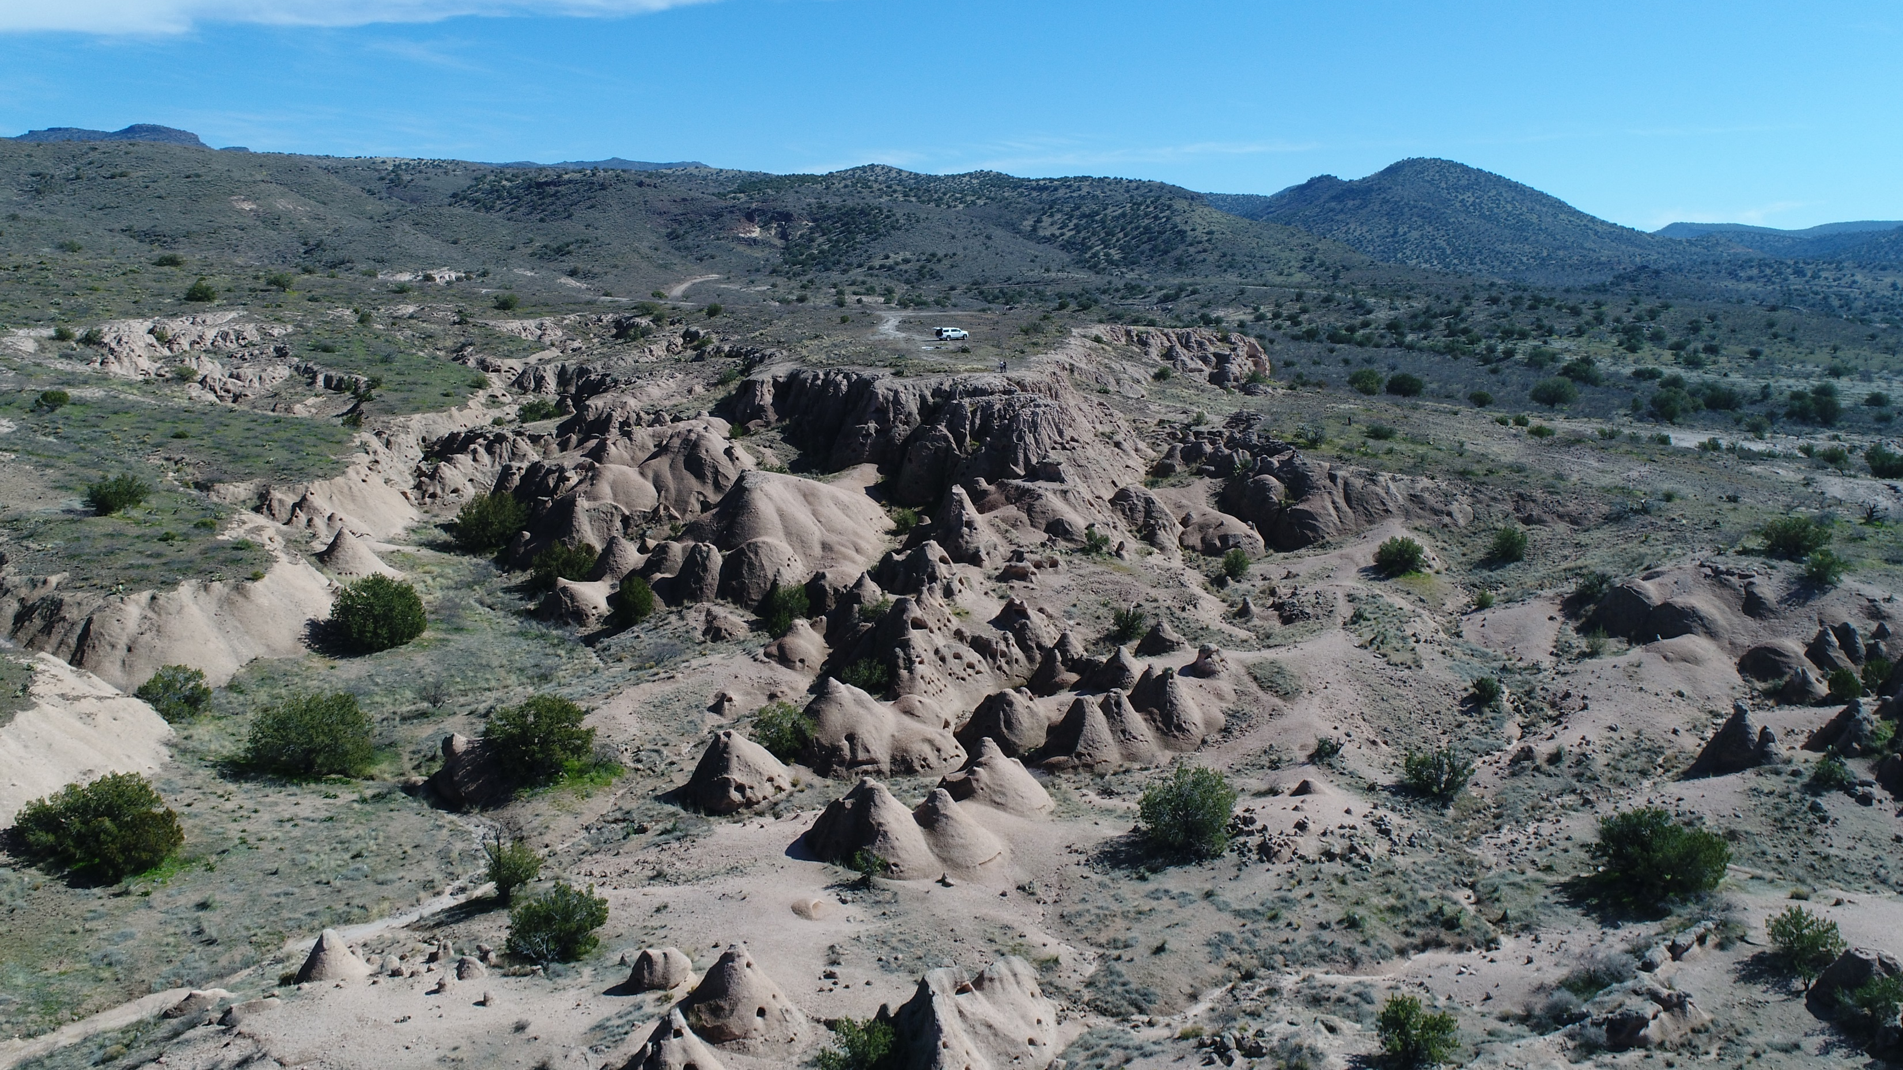



A Fossilized Rootless Hydrothermal System in the Cottonwood sub basin of the Verde Valley, AZ
By Emily Kunkle and mentor Lisa Thompson

Slide 2
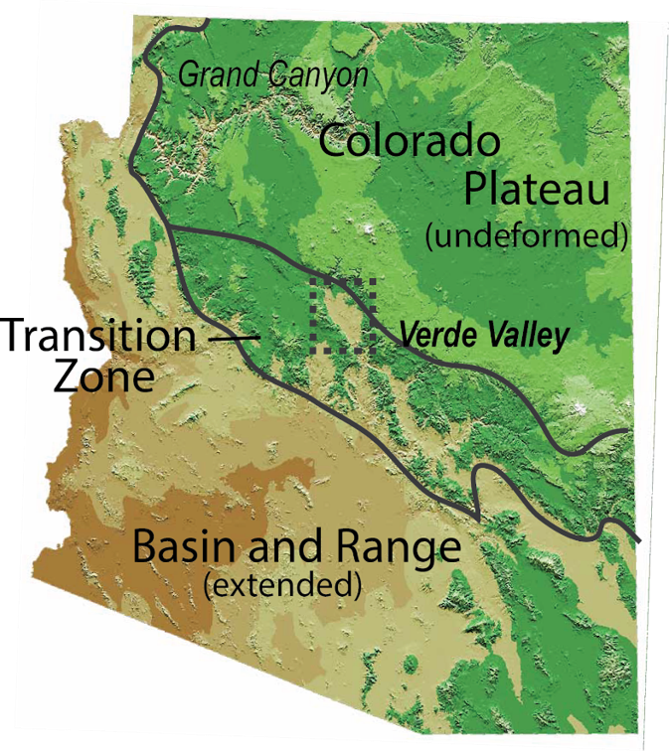
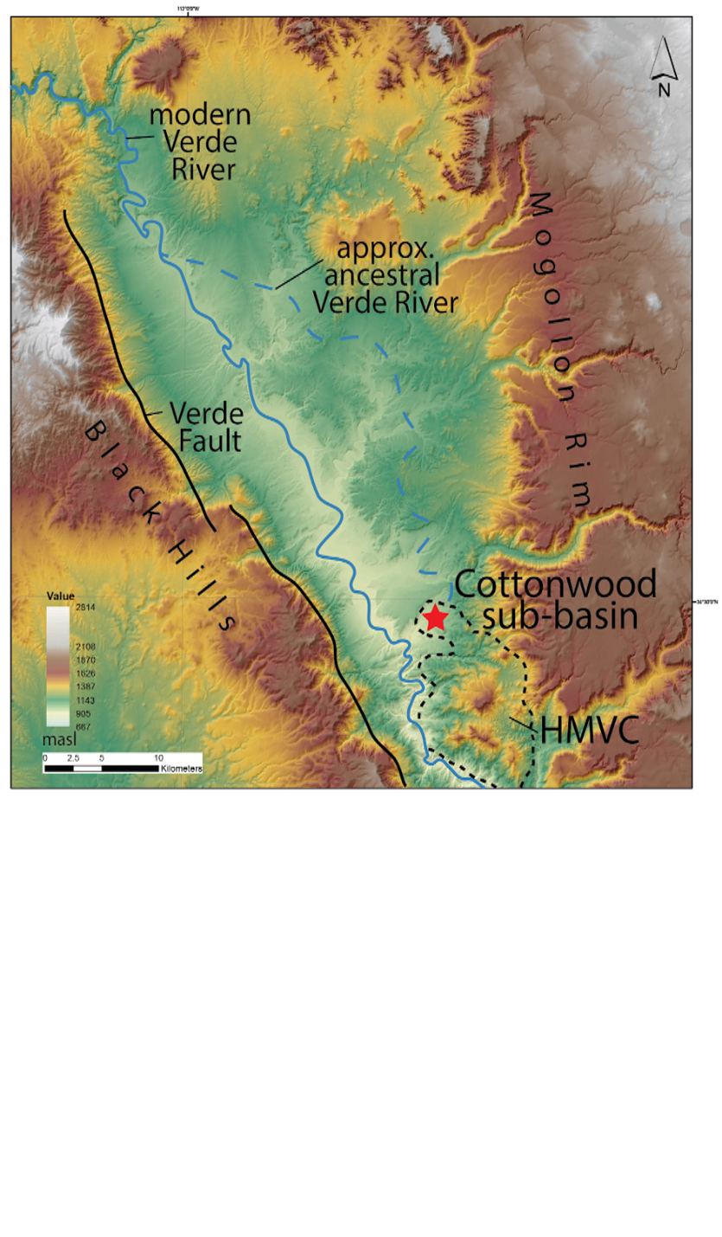
Hackberry Mountain Volcanic Center (HMVC) erupted between 11.5-7.5 Ma
7 members of pyroclastic flows, Towel Creek tuff – 8 Ma

Slide 3
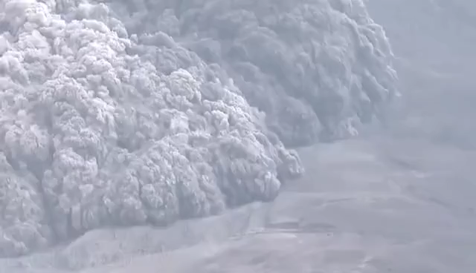
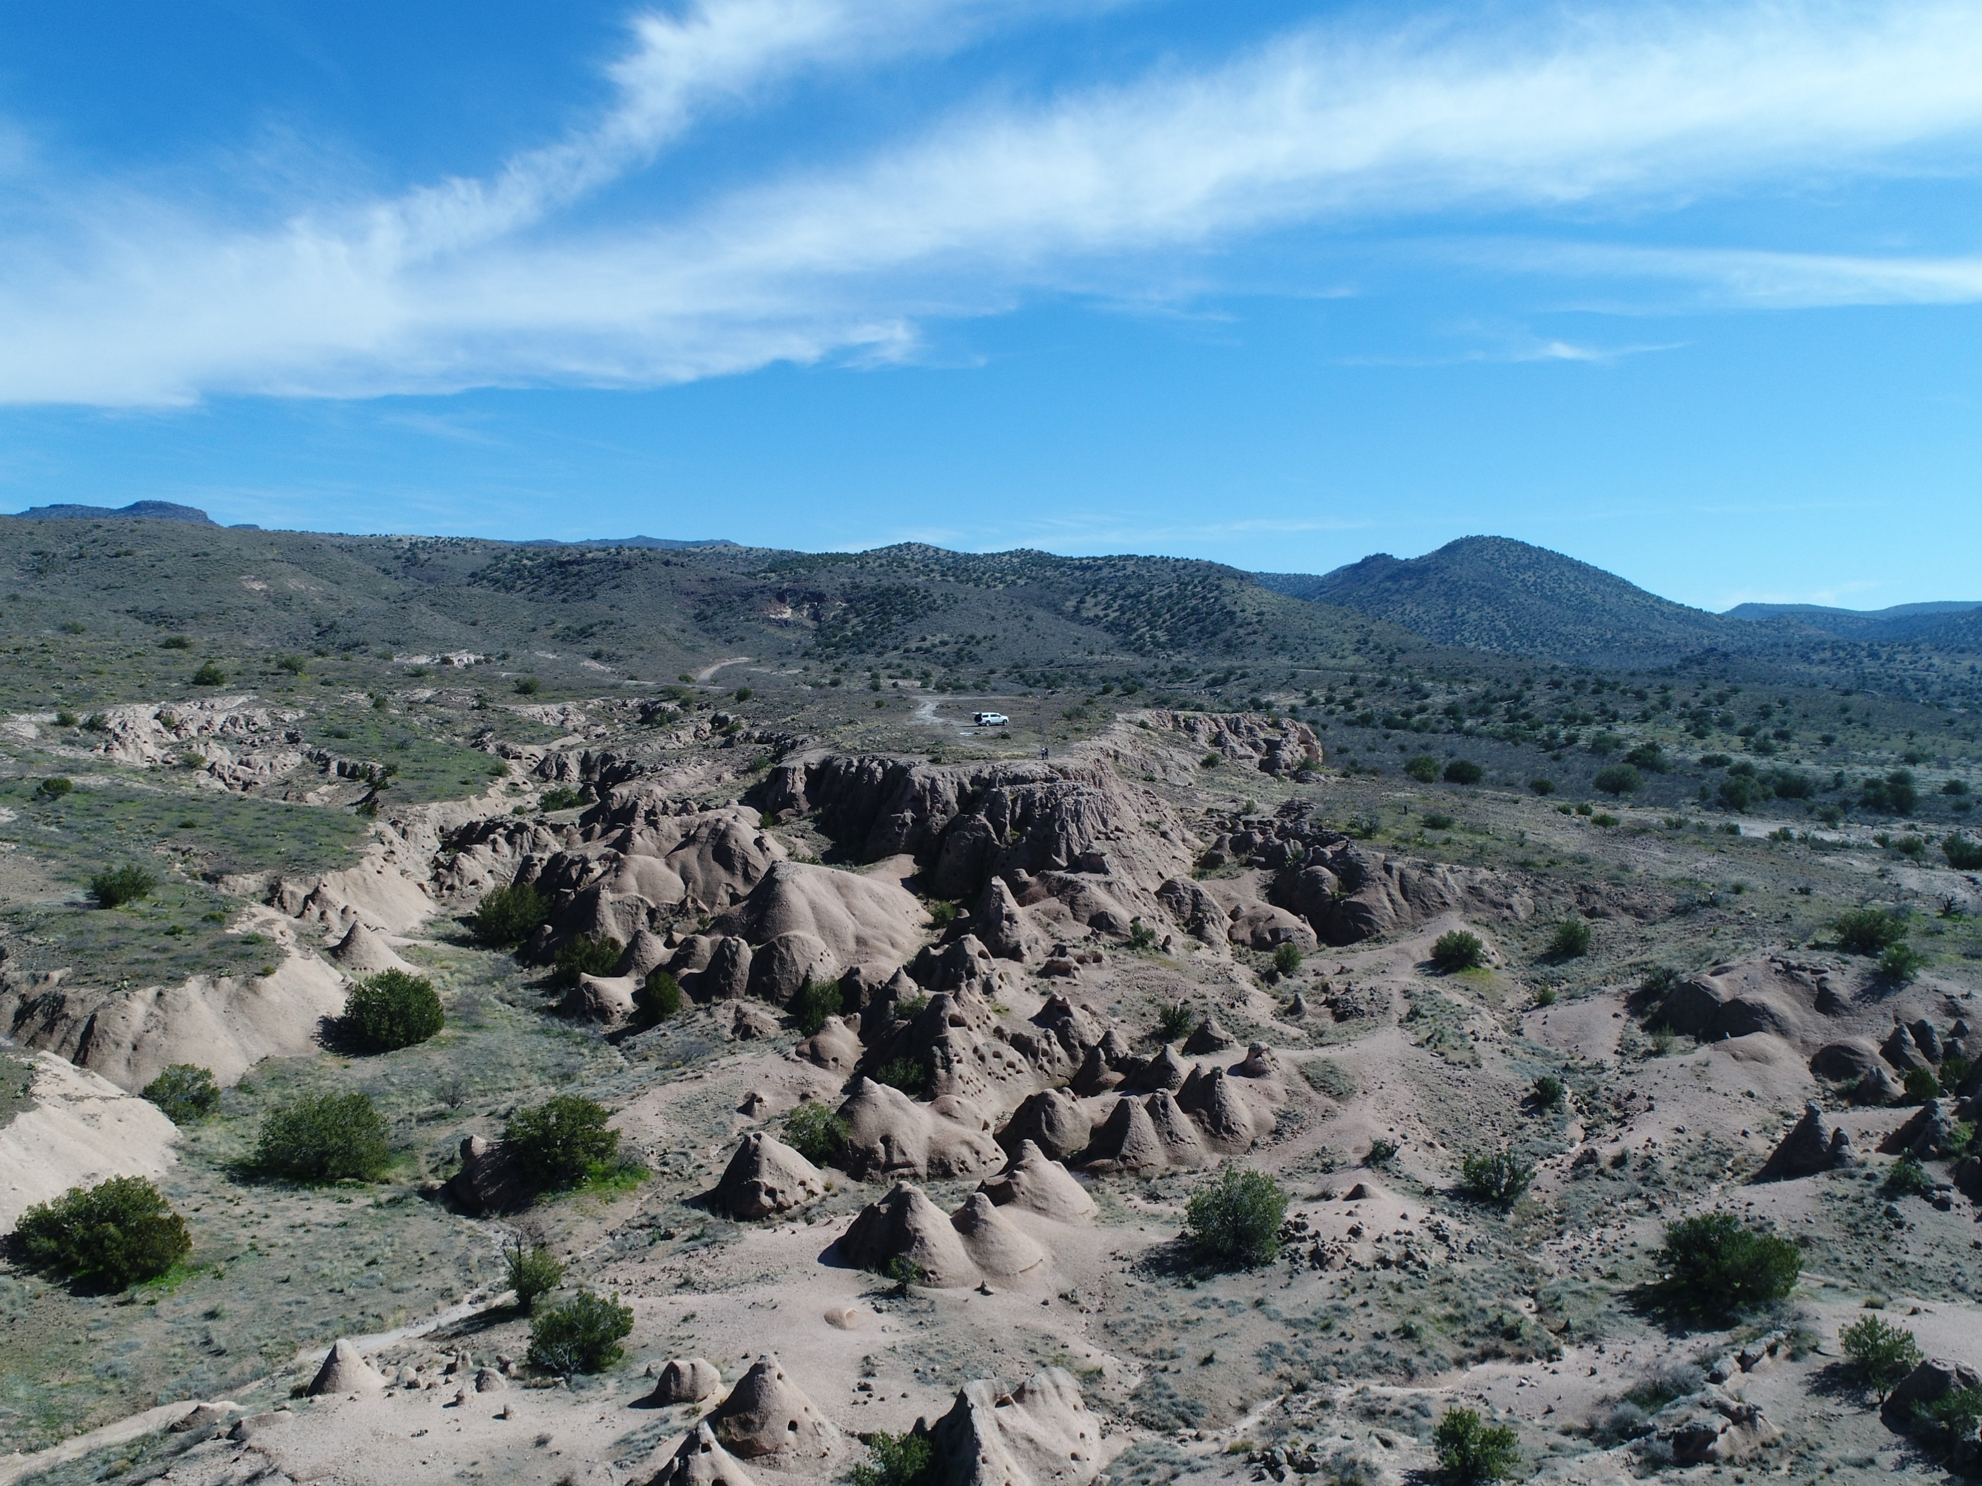
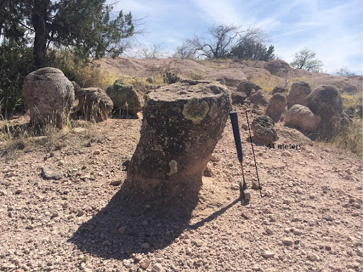
What is a pyroclastic flow?
Pyroclastic flow
Field area
Definition: a dense cloud of ash, pumice, and other rocks explosively erupted from a volcano that moves down slope at speeds up to 400mph covering anything in its path
A pyroclastic flow deposit is called a “tuff”
Cemented tuff forms

Slide 4
What is the specific origin of the cemented tuff forms?
How much water was present?
What are the physical laws that govern their shape?
What depositional environment existed on the surface before the tuff was emplaced?
Hypothesis:
A pyroclastic flow encountered standing water and flash heated it to steam, that crystallized forming various shapes of cemented tuff
Questions that guided the project:

Slide 5
How does this project align with NASA research interests?
All the rocky planets have a volcanic past
Life on earth evolved at volcanic hydrothermal vents
The search for life on other planets relies on surface water present on other planets
My field area could be a terrestrial analog for identifying ancient hydrothermal systems on other planets!
Geologists identify terrestrial analog environments in order to inform NASA mission planning on where to send instrumentation and astronauts

Slide 6
Methods
The Data | How data is used
Drone data | Capture high resolution imagery
Digital elevation model (DEM) | Calculate the volumes of cemented forms
Stratigraphic sections | To interpret depositional environment before tuff was emplaced
Thin sections | To understand chemical componentry of cemented forms

Slide 7
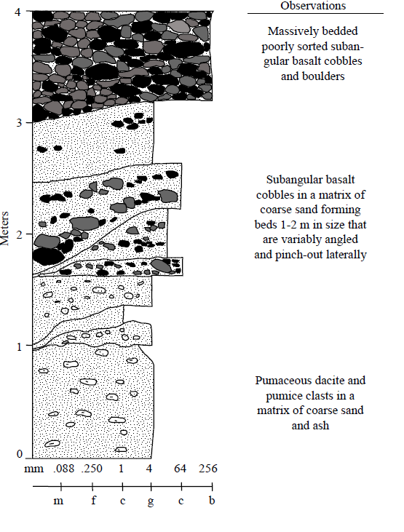
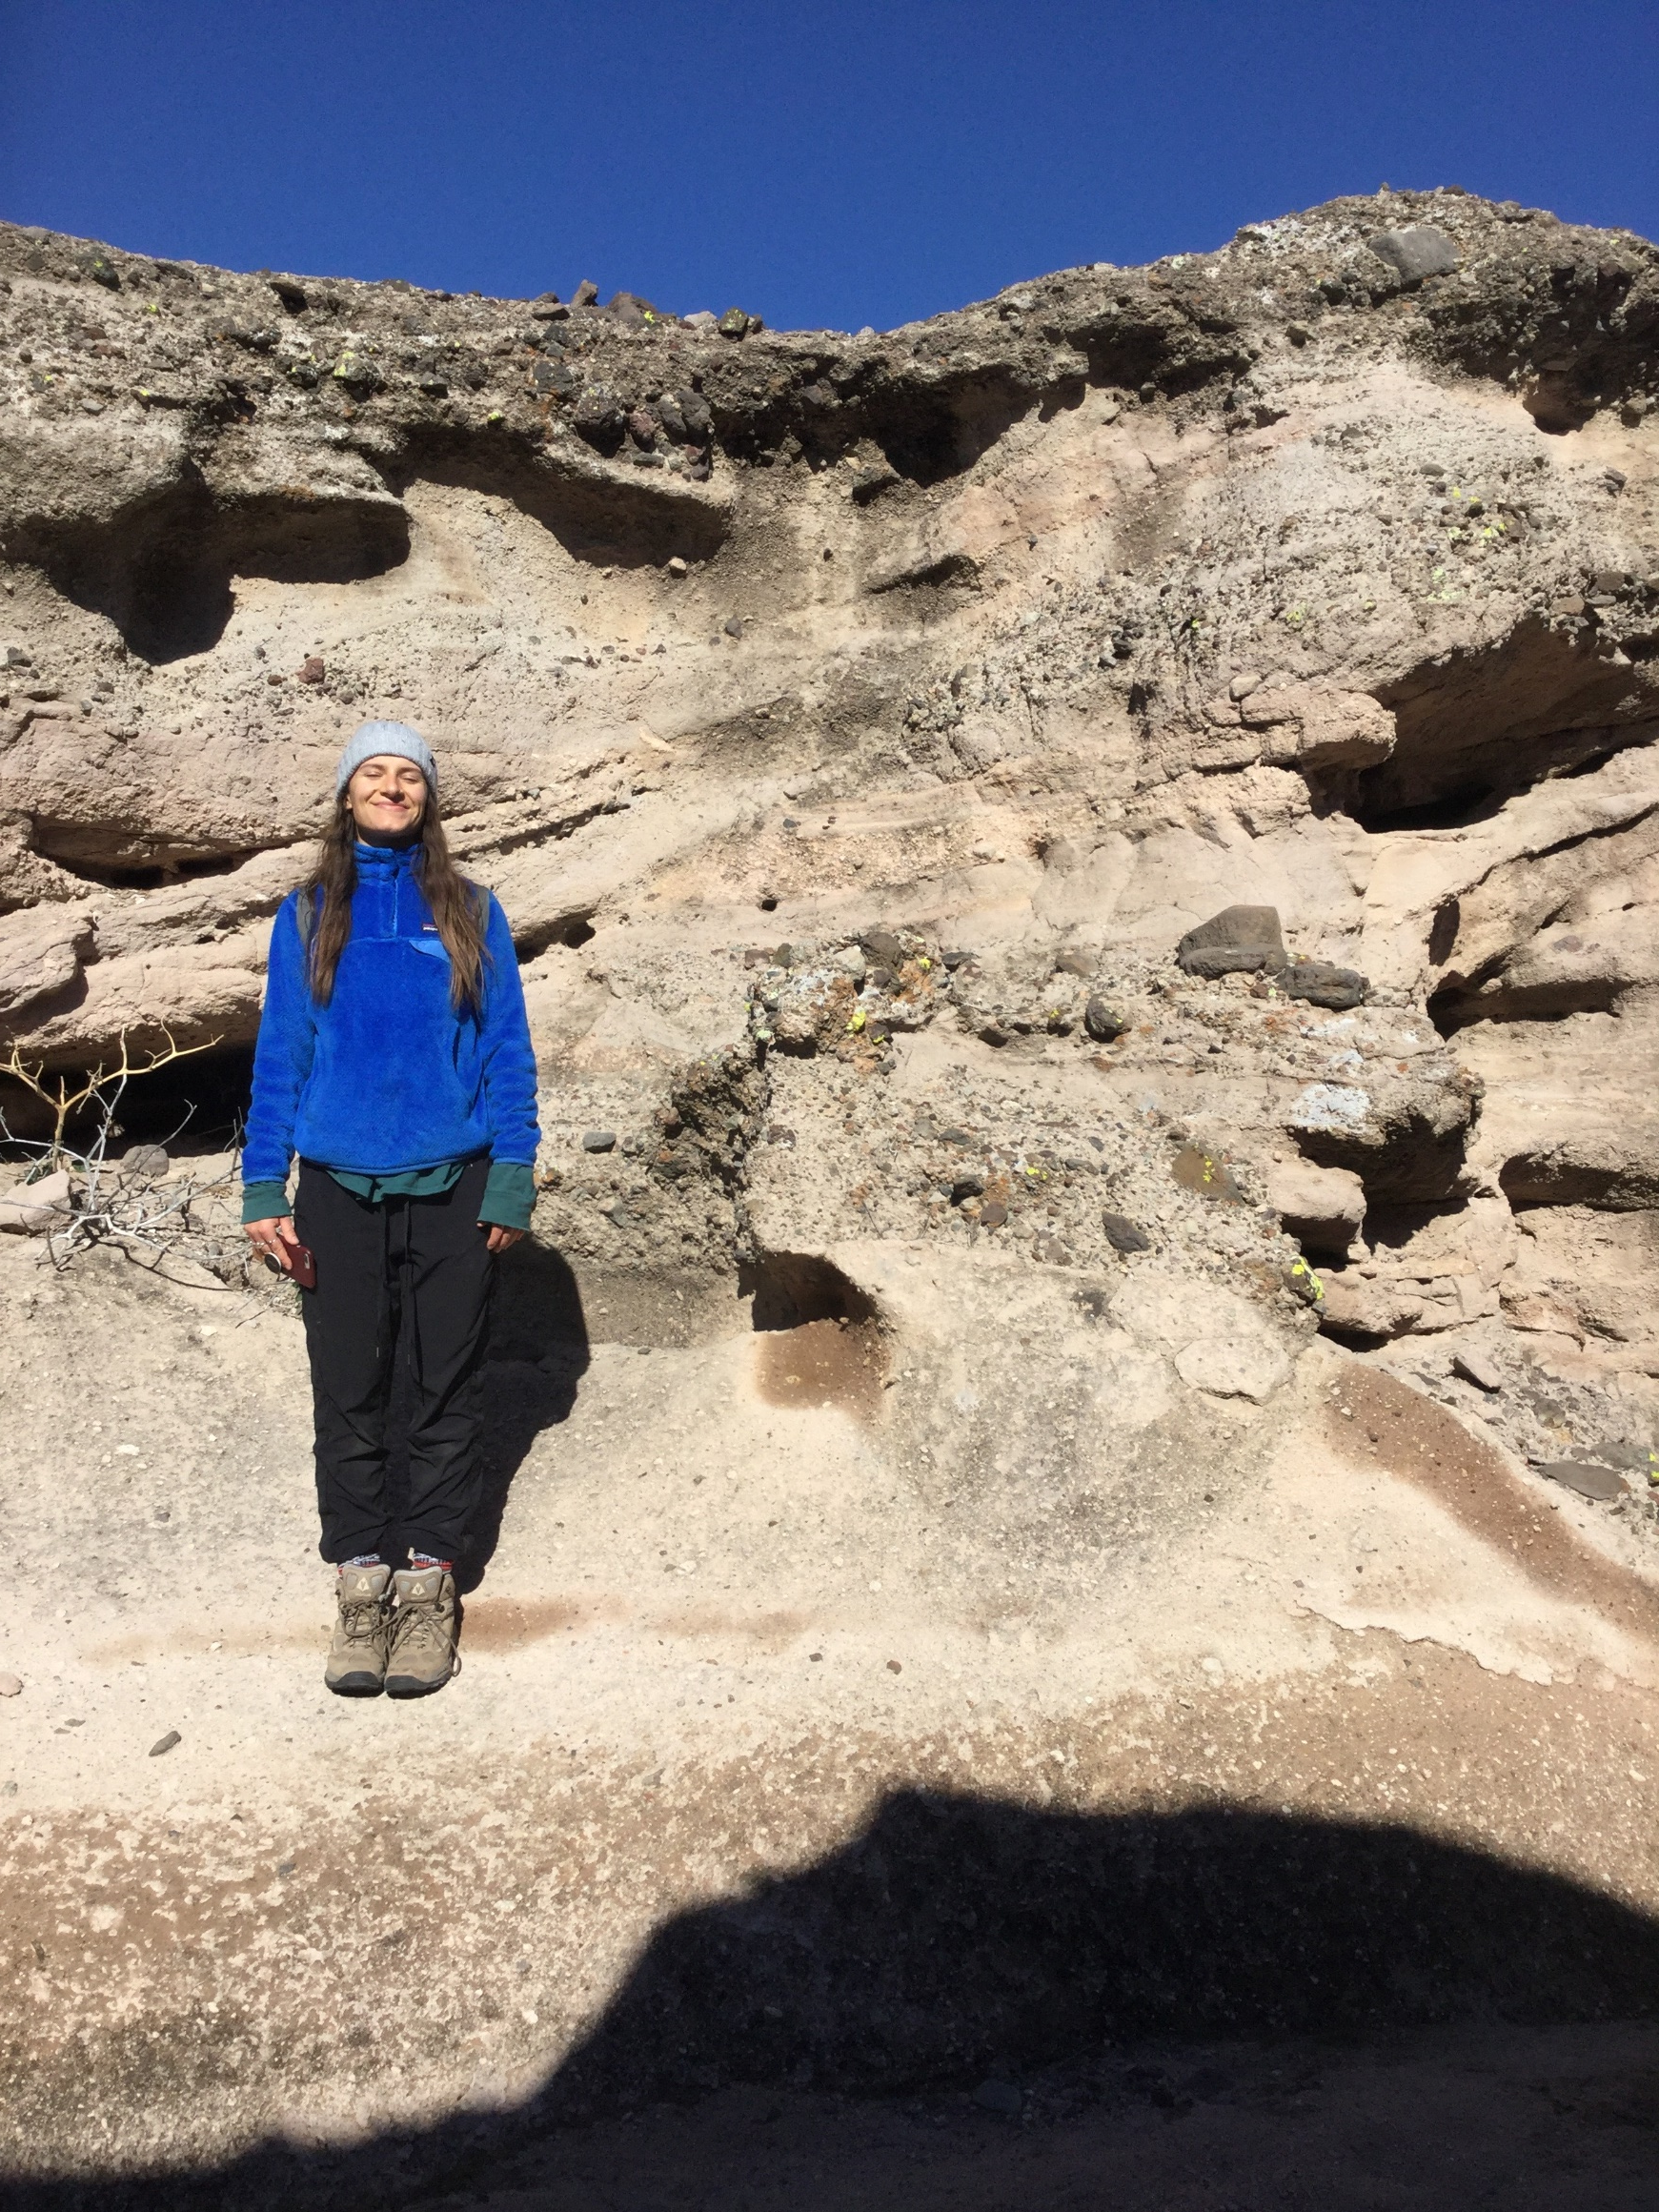
Stratigraphic Sections: to describe rock unit and how it formed
Sedimentary rock unit

Slide 8
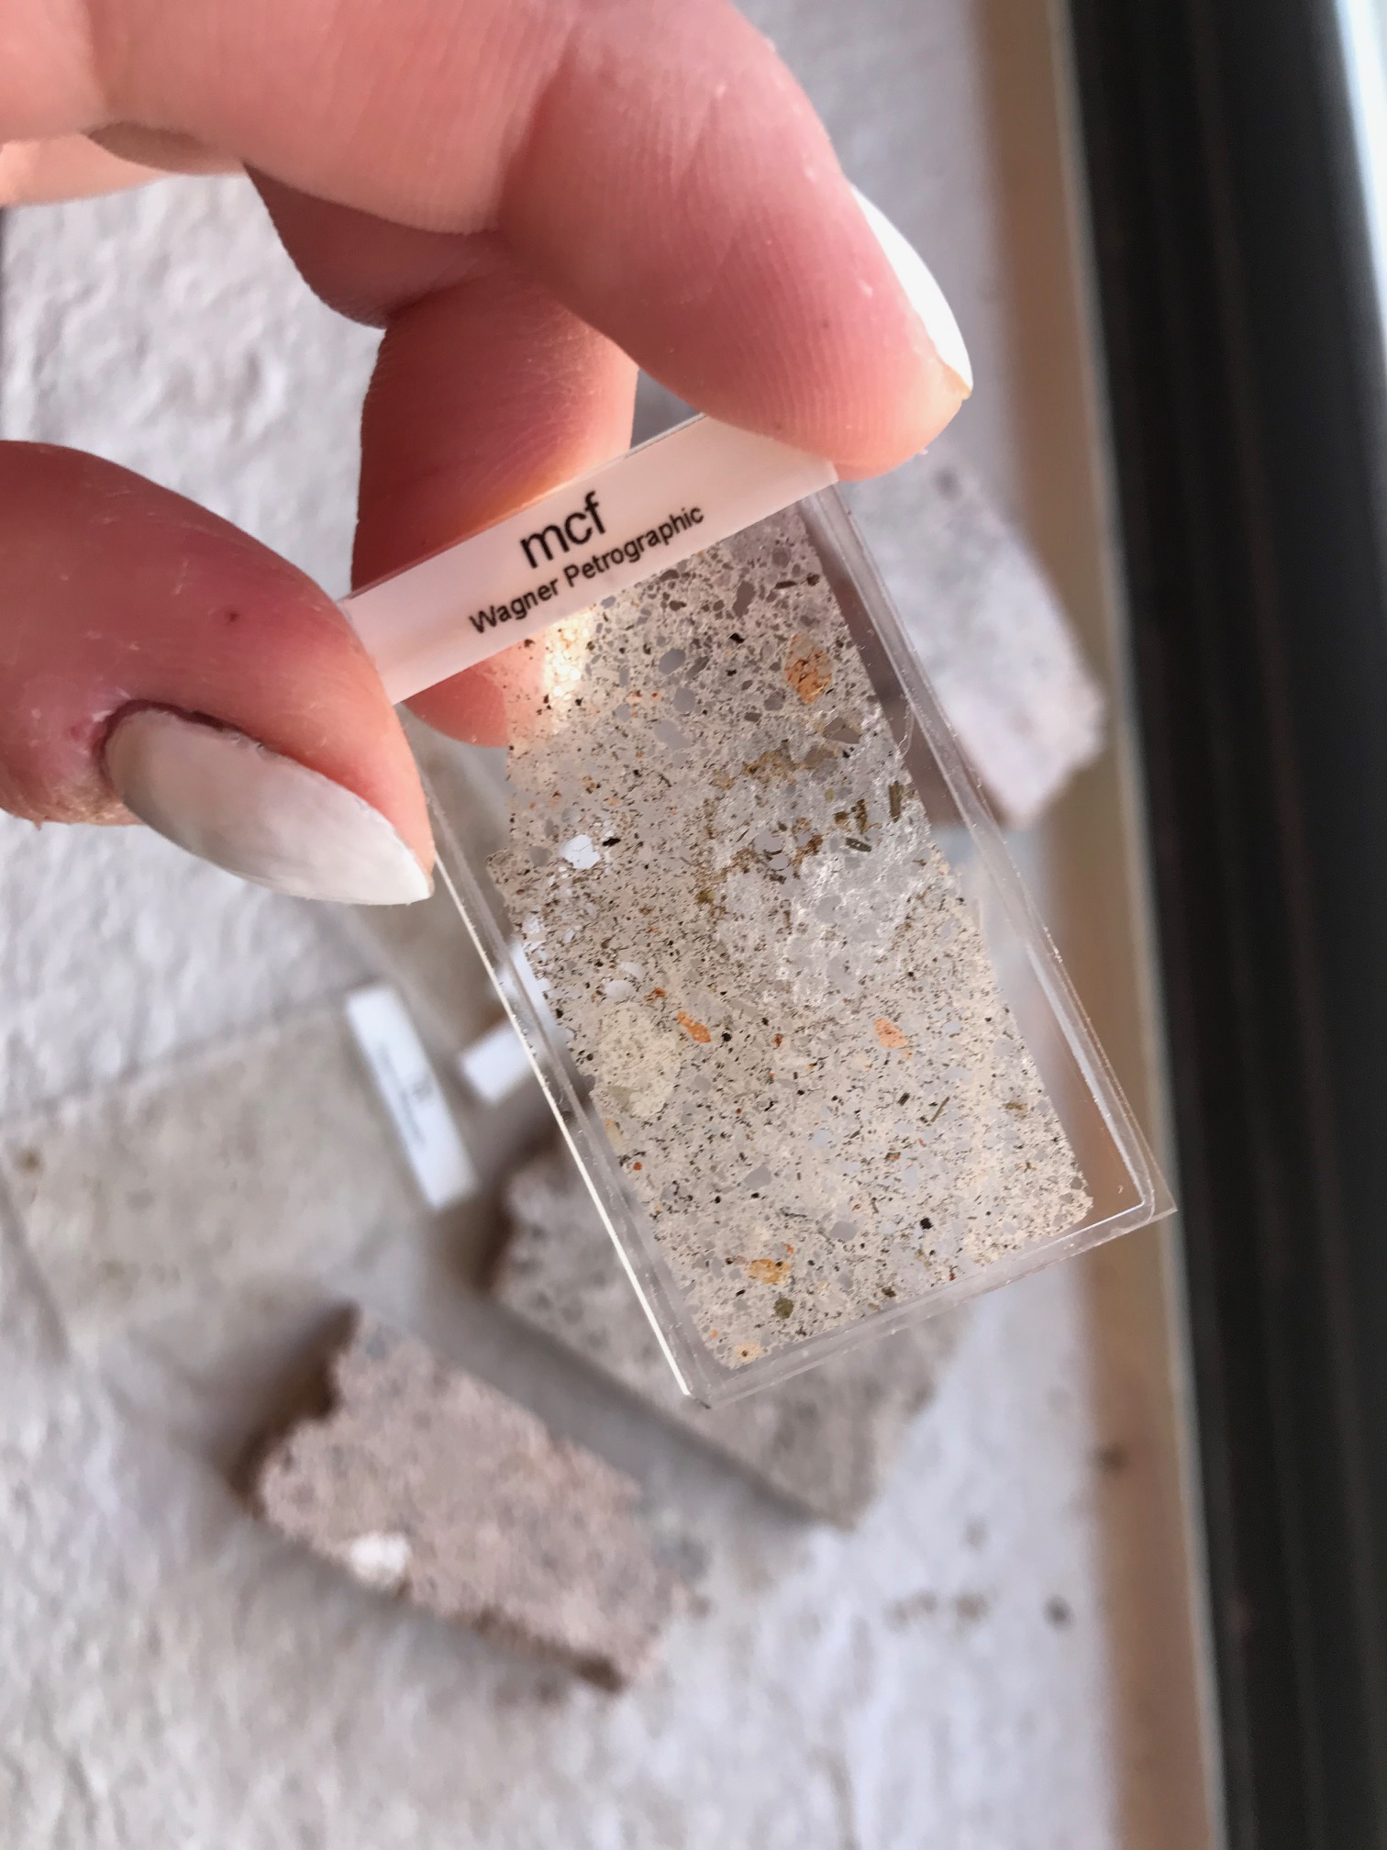
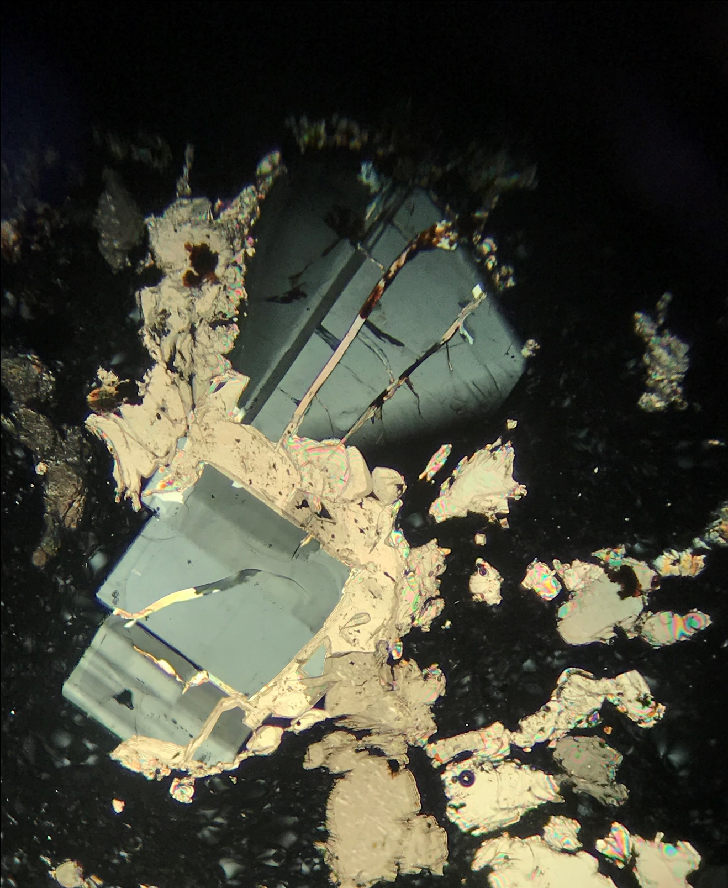
Thin section under cross polarized light
Thin sections of cemented forms

Slide 9
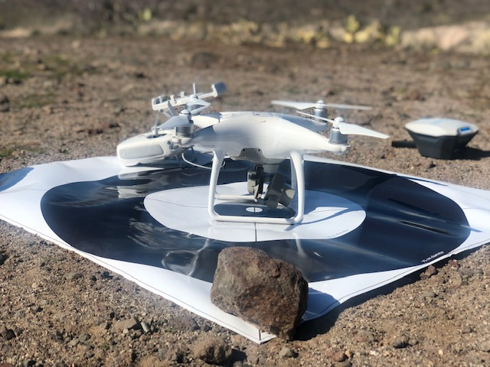
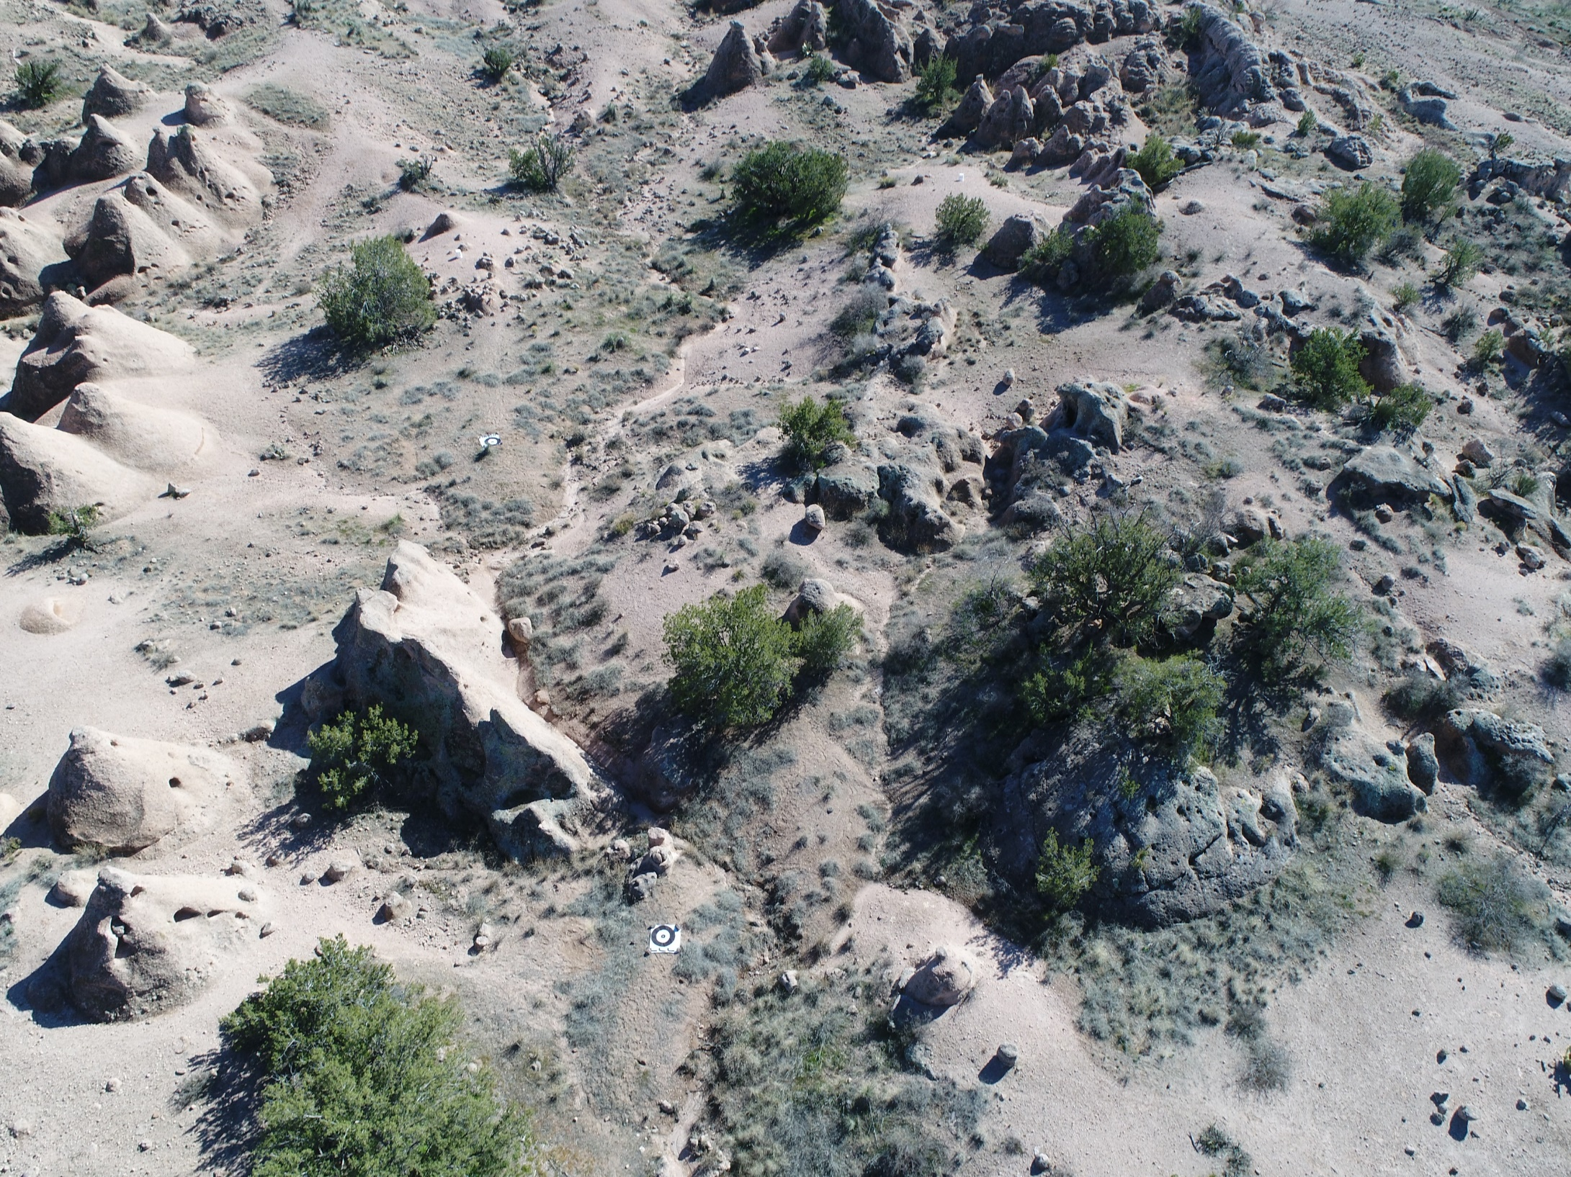
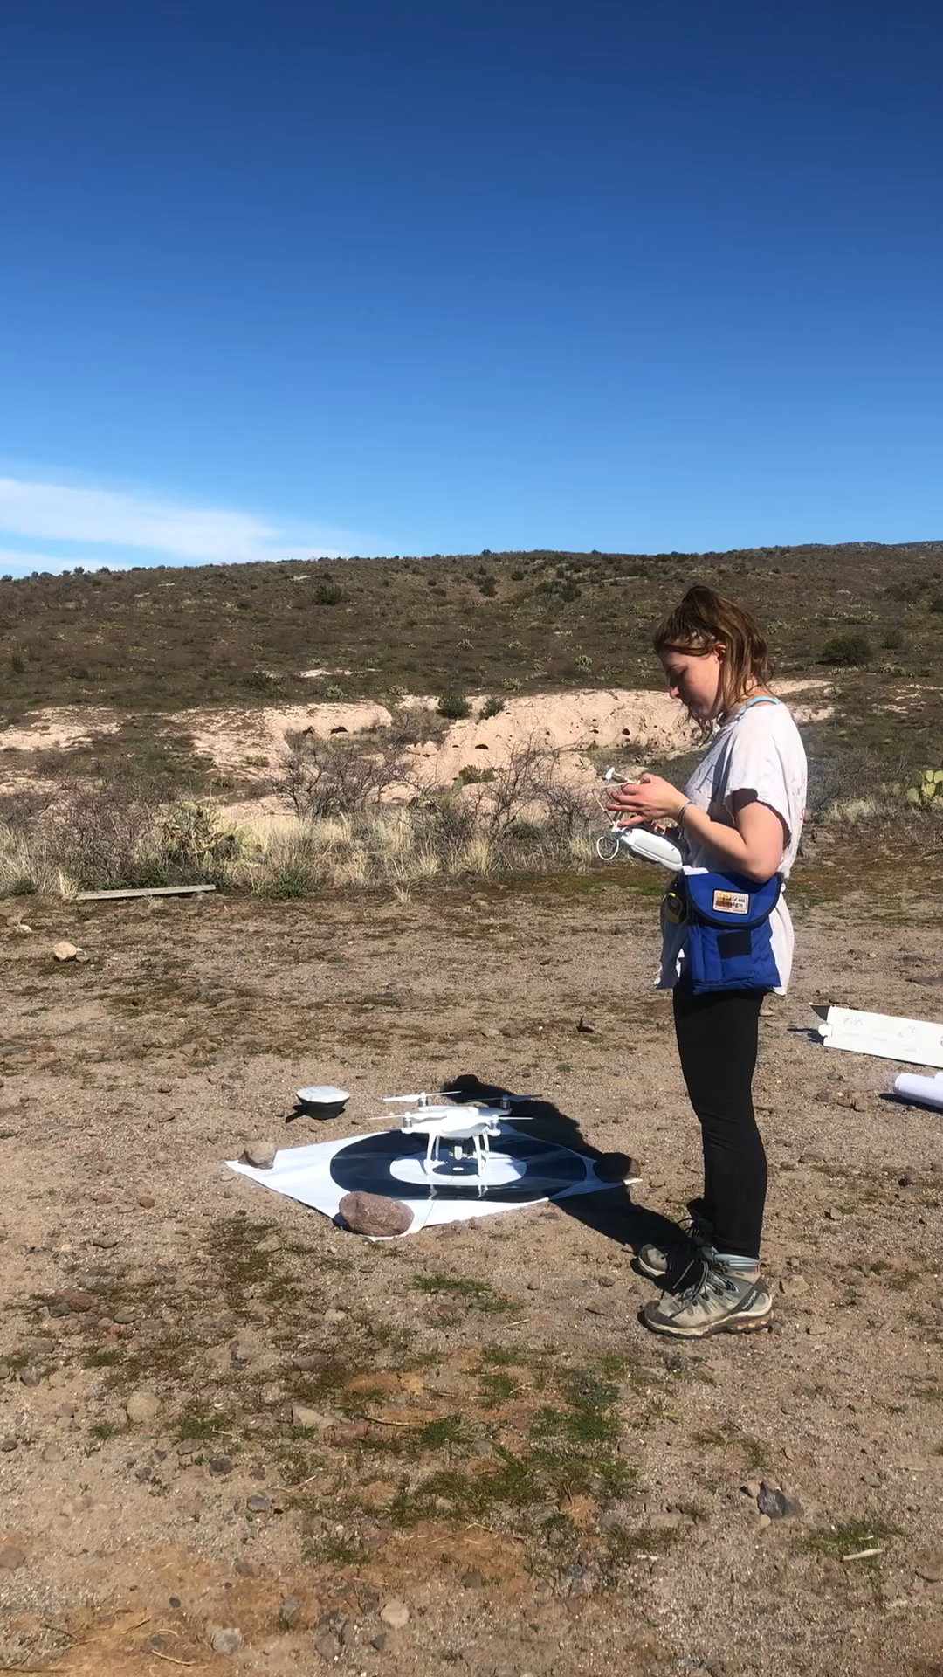
Drone Methodology
Mr. Droney McDroneface
Goal
Capture high resolution imagery to build a DEM and extract volume of cemented forms
Drone image

Slide 10
What’s Next?
Still processing drone images to make DEM
Calculate volume of a given number of cemented forms
Volumetric analysis of calcite from thin sections
How much calcite precipitates from how much water?
%Cemented form x %calcite →How many kg calcite→ How many liters of water

Slide 11
Acknowledgements
Arizona Space Grant Consortium and NAU Nasa Space Grant program
Lisa Thompson, project mentor
Dr. Brad Fobar, physics consultant
Dr. Christine Regalla, for letting us borrow her drone and helping us learn how to use it
Field companions: Reese Koltvet, Kendall Tipton, Qualia Coleman, and Bailey Estes
Questions?

Slide 12
